Slide 1
SQL Day 1

Slide 2
What we have covered so far….
Section 1 : Data, Databases and Relational Data Base Management Systems.
Section 2 : VM, Windows Server Installation and managing Lab VM.

Slide 3
Welcome to Download, Install and Configure Microsoft SQL

Slide 4
What We will Cover in this Section
Prerequisites for MSSQL installation.
Download MSSQL and SQL Server Management Studio.
Install and Configure MSSQL.
Install SQL Server Management Studio.
Download and install AdventureWorks database.

Slide 5
Prerequisites for MSSQL Installation

Slide 6
Hardware requirements:
Component | Requirement | Recommended
Hard Disk | SQL Server requires a minimum of 6 GB of available hard-disk space | NTFS or ReFS file formats is recommended. FAT32 file system is supported but not recommended
Memory | Express Editions: 512 MB All other editions: 1 GB | Express Editions: 1 GB All other editions: At least 4 GB
Processor Speed | x64 Processor: 1.4 GHz | 2.0 GHz or faster
Processor Type | x64 Processor: AMD Opteron, AMD Athlon 64, Intel Xeon with Intel EM64T support, Intel Pentium IV with EM64T support

Slide 7
Software requirements
Component | Requirement
.NET Framework | require .NET Framework 4.6 for the Database Engine, Master Data Services, or Replication
Network Software | Supported operating systems for SQL Server have built-in network software.

Slide 8
Considerations…
Installation of SQL Server 2016 is supported on x64 processors only. It is no longer supported on x86 processors.
SQL Server 2016 Can be installed on Windows Server 2012, 2016 and 2019.
You cannot run SQL Server services on a domain controller under a local service account.
Separate disks for Data Files, Log Files and tempdb.

Slide 9
Prerequisites for MSSQL 2022 Installation

Slide 10
Hardware requirements:
Component | Requirement | Recommended
Hard Disk | SQL Server requires a minimum of 6 GB of available hard-disk space | NTFS or ReFS file formats is recommended. FAT32 file system is supported but not recommended
Memory | Express Editions: 512 MB All other editions: 1 GB | Express Editions: 1 GB All other editions: At least 4 GB
Processor Speed | x64 Processor: 1.4 GHz | 2.0 GHz or faster
Processor Type | x64 Processor: AMD Opteron, AMD Athlon 64, Intel Xeon with Intel EM64T support, Intel Pentium IV with EM64T support

Slide 11
Software requirements
Component | Requirement
Operating system | Windows 10 TH1 1507 or greater Windows Server 2016 or greater.
.NET Framework | require .NET Framework 4.6 for the Database Engine, Master Data Services, or Replication
Network Software | Supported operating systems for SQL Server have built-in network software.

Slide 12
Considerations…
Installation of SQL Server 2022 is supported on x64 processors only.
SQL Server 2022 Can be installed on Windows Server 2016, 2019 and 2022.
You cannot run SQL Server services on a domain controller under a local service account.
Separate disks for Data Files, Log Files and tempdb.

Slide 13
Install and Configure MSSQL

Slide 14
Install and Configure MSSQL

Slide 15
Production Environment…
Most Powerful Machines.
96+ CPU.
256+ GB RAM.
Solid State Drives for OS.
Terabytes of Storage Attached.
Data Files, Log Files, tempdb and backups on separate disk drives

Slide 16
Install SQL SERVER MANAGEMENT STUDIO (SSMS)

Slide 17
Download and Install AdventureWorks Database

Slide 18
What we have covered so far….
Section 1 : Data, Databases and Relational Data Base Management Systems.
Section 2 : VM, Windows Server Installation and managing Lab VM.
Download, Install and Configure MS SQL Server

Slide 19
Database Fundamentals and Design

Slide 20
What We will Cover in this Section
What is Data ?
What is a Database?
What is RDBMS?
How is Data Stored?
ACID properties.
Table, Column, ROW…
Keys, PK, FK UK…
Normalization.
Creating our first DB and populating data.

Slide 21
What is DATA…

Slide 22
Data is a collection of facts, such as numbers, words, measurements, observations or just descriptions of things.
Raw data - that needs to be processed to give it meaning.
Information – processed data which have meaning.
Data, in the context of databases, refers to all the single items that are stored in a database, either individually or
as a set.

Slide 23



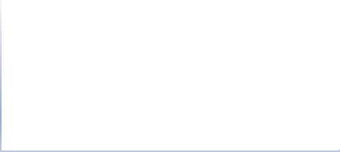

Complete SQL Training Master Class to Get Your Dream IT Job Section 3
Qualitative VS Quantitative Data
Data
Qualitative (party was FUN)
Quantitative (Numerical)
Discrete Usually Counted (5 Dog, 100 Cars)
Continuous Usually Measured (18 cm, 30 grams)

Slide 24
What is Database…

Slide 25
Database
Base : "a structure on which something rests"
Data Base – “a structure that holds data”.

Slide 26

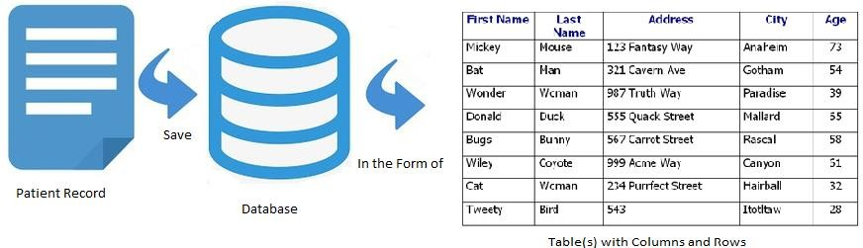
Database: an organized collection of structured information, or data, typically stored electronically in a computer system.
Complete SQL Training Master Class to Get Your Dream IT Job Section 3
Traditional File System
Database

Slide 27
Difference between a Database and Spreadsheet?
Complete SQL Training Master Class to Get Your Dream IT Job Section 3
How the data is stored and manipulated.
Who can access the data.
How much data can be stored.

Slide 28
How is Data stored ?

Slide 29
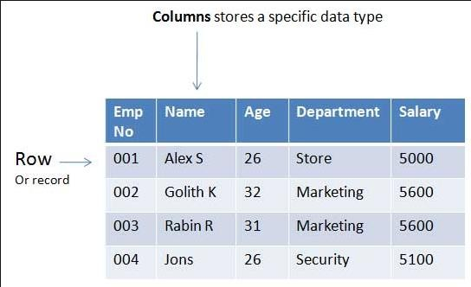
Complete SQL Training Master Class to Get Your Dream IT Job Section 3
Inside a database, data is stored into tables.
Structured Query Language (SQL).
data has to be stored in a standardized manner.
data is stored in a database in tables, but tables are not the database.

Slide 30
What is a Table, Column and ROW?

Slide 31
What is a Table..
Relational database system contains one or more objects called tables.
The data or information for the database are stored in
these tables.
Tables are uniquely identified by their names
The number of tables in a database is limited only by the number of objects allowed in a database (2,147,483,647) for MSSQL.
MySQL has no limit on the number of tables.

Slide 32
What is a Column…
Column is a set of data values, all of a single type, in a table.
Columns define the data in a table.
A column may contain text values, numbers, or even pointers to files in the operating system.
Column name is unique in table.
Maximum no of Columns in SQL server is 1024.
Maximum no of Columns in MySQL is 4096.
Table need at least one column.
Field = Column.
Field is the intersection of a row and a column.

Slide 33
What is a ROW…
In database terms, a row is a collection of fields that make up a
record.
A row is also called a record.
Each row represents a unique record.
A table can contain zero or more rows. When there are zero, it
said to be empty table.
The number of rows in the table is limited only by the storage capacity of the server.

Slide 34
What is a Key?

Slide 35
What is a Key..
A Key is a data item that exclusively identifies a record.
Keys are also used to generate relationship among different database tables.
Key can be single attribute of a group of attribute.
StudentID | Name | Class | DOB | Email
1001 | John | 1st Year | 01-08-2008 | john1@mycollege.com
1002 | Edward | 3rd Year | 04-12-2005 | edward@mycollege.com
1002 | Peter | 4th Year | 03-09-2003 | peter@mycollege.com
1004 | Smith | 2nd Year | 09-30-2006 | smith@mycollege.com
1005 | John | 1st Year | 01-17-2007 | john2@mycollege.com

Slide 36
Different Type of Keys…

Slide 37
Candidate Key
A Candidate key is an attribute or set of attributes that uniquely identifies a record.
Table can.
Among the set of candidate, ohave multiple candidate keysne candidate key is chosen as Primary Key.
StudentID | Name | Class | DOB | Email
1001 | John | 1st Year | 01-08-2008 | john1@mycollege.com
1002 | Edward | 3rd Year | 04-12-2005 | edward@mycollege.com
1003 | Peter | 4th Year | 03-09-2003 | peter@mycollege.com
1004 | Smith | 2nd Year | 09-30-2006 | smith@mycollege.com
1005 | John | 1st Year | 01-17-2007 | john2@mycollege.com
studentInfo Table

Slide 38
Primary Key
Primary key is a set of one or more fields ( columns) of a table that uniquely identify a record in database table.
A table can have only one primary key and one candidate key can select as a primary key.
The primary key should be chosen such that its attributes are never or rarely changed.
Cannot contain “NULL”.
Primary key field contain a clustered index.
StudentID | Name | Class | DOB | Email
1001 | John | 1st Year | 01-08-2008 | john1@mycollege.com
1002 | Edward | 3rd Year | 04-12-2005 | edward@mycollege.com
1003 | Peter | 4th Year | 03-09-2003 | peter@mycollege.com
1004 | Smith | 2nd Year | 09-30-2006 | smith@mycollege.com
1005 | John | 1st Year | 01-17-2007 | john2@mycollege.com
studentInfo Table

Slide 39
Secondary Key
Candidate keys that are not selected as primary key.
Can also work as a primary key.
Also called Alternate key.
StudentID | Name | Class | DOB | Email
1001 | John | 1st Year | 01-08-2008 | john1@mycollege.com
1002 | Edward | 3rd Year | 04-12-2005 | edward@mycollege.com
1003 | Peter | 4th Year | 03-09-2003 | peter@mycollege.com
1004 | Smith | 2nd Year | 09-30-2006 | smith@mycollege.com
1005 | John | 1st Year | 01-17-2007 | john2@mycollege.com
studentInfo Table

Slide 40
Unique Key:
A unique key is a set of one or more attribute that can be used to uniquely identify the records in table.
Unique key is similar to primary key but unique key field can contain a “Null” value but primary key doesn’t allow “Null” value.
Unique field contain a non-clustered index.
StudentID | Name | Class | DOB | Email
1001 | John | 1st Year | 01-08-2008 | john1@mycollege.com
1002 | Edward | 3rd Year | 04-12-2005 | edward@mycollege.com
1002 | Peter | 4th Year | 03-09-2003 | peter@mycollege.com
1004 | Smith | 2nd Year | 09-30-2006 | smith@mycollege.com
1005 | John | 1st Year | 01-17-2007 | john2@mycollege.com
studentInfo Table

Slide 41
Composite Key:
Composite key is a combination of more than one attributes that can be used to uniquely identity each record.
A composite key may be a candidate or primary key.
StudentID | Name | Class | DOB | Email
1001 | John | 1st Year | 01-08-2008 | john1@mycollege.com
1002 | Edward | 3rd Year | 04-12-2005 | edward@mycollege.com
1003 | Peter | 4th Year | 03-09-2003 | peter@mycollege.com
1004 | Smith | 2nd Year | 09-30-2006 | smith@mycollege.com
1005 | John | 1st Year | 01-17-2007 | john2@mycollege.com
studentInfo Table

Slide 42
Foreign Key:
Foreign Key is a field in database table that is Primary key in another table.
Foreign key is used to generate the relationship between the tables.
A foreign key can accept null and duplicate value.
studentInfo Table
invoiceInfo Table
StudentID | Name | Class | DOB | Email
1001 | John | 1st Year | 01-08-2008 | john1@mycollege.com
1002 | Edward | 3rd Year | 04-12-2005 | edward@mycollege.com
1003 | Peter | 4th Year | 03-09-2003 | peter@mycollege.com
1004 | Smith | 2nd Year | 09-30-2006 | smith@mycollege.com
1005 | John | 1st Year | 01-17-2007 | john2@mycollege.com
StudentID | InvoiceNo | Amount | InvoiceDate
1001 | A-5789 | $1500.00 | 04-11-2020
1002 | A-8854 | $1000.00 | 05-17-2019
1002 | A-9845 | $250.00 | 07-25-2020
1004 | A-2323 | $750.00 | 01-18-2021
1011 | A-6841 | $70.00 | 12-13-2021

Slide 43
What is a Transaction and what are ACID properties?

Slide 44
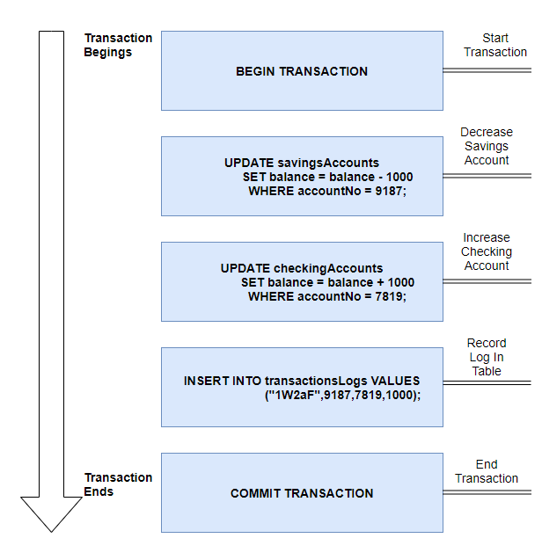
What is a Transaction…
A transaction is a single logical unit of work which accesses and possibly modifies the contents of a database.
Transactions access data using read and write operations.
A transaction groups SQL statements so that they are either all committed, which means they are applied to the database, or all rolled back, which means they are undone from the database.
Transfer $1000.00 from my Savings Account 9187 to Checking Account 7819.

Slide 45
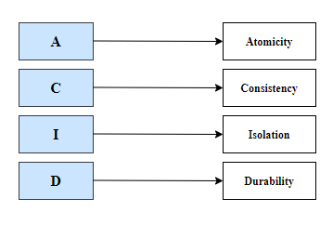
ACID Properties
ACID is a concept (and an acronym) that refers to the four properties of a transaction in a database system, which are: Atomicity, Consistency, Isolation and Durability.
These properties ensure the accuracy and integrity of the data in the database.
Ensuring that the data does not become corrupt as a
result of some failure.
Because of the ACID properties, we can focus on the application logic instead of failures, recovery and sync of the data.

Slide 46
Atomicity…
A transaction must be an atomic unit of work.
that is, either all of its operations are executed or
none.
Failure
The transaction should be completely executed or fails completely, if one part of the transaction fails, all the transaction will fail.
This provides reliability because if there is a failure in the middle of a transaction, none of the changes in that transaction will be committed.

Slide 47
Consistency…
The database must remain in a consistent state after any transaction.
ensures that the transaction maintains data
integrity constraints, leaving the data consistent.
It also refers to the correctness of a database.
The data that is saved in the database must always be valid.
The data will be valid according to defined rules, including any constraints.
If you have a column that does not allow negative numbers, and try to add or modify a record, using a value lower than zero on this column, the transaction will fail.

Slide 48
Isolation…
All the transactions will be carried out and executed as if it is the only transaction in the system. No transaction will affect the existence of any other transaction.
Ensuring that the transaction will not be changed by any other concurrent transaction.
For example, if two clients are trying to buy at the same time the last available product on the web site, when the first user finishes the shopping, it will make the transaction of the other user be interrupted.

Slide 49
Durability…
Once a transaction is completed and committed, its changes are persisted permanently in the database.
Ensures that the information that is saved in the database is immutable until another update or deletion transaction affects it.
For this purpose, the completed transactions are recorded on permanent memory devices (non- volatile) such as hard drives, so the data will be always available, even if the DB instance is restarted.
Changes Saved to DISK

Slide 50
What is Normalization and different forms of Normalization ?

Slide 51
Why we need Normalization…
Data Redundancy.
Waste of disk space.
Creates maintenance problems.
Inconsistent dependency.
orderDetails table
orderID | orderDate | orderTotal | operatorID | custID | custName | custAddress | custEmail | custPhone
A-231 | 01/13/2019 | 300.00 | NY-203 | 2325 | Edward | 29 Samsung Street, Queens,NY 11859 | edward@outlook.com |  | 324-987-3587, 324-897-3582
Z-980 | 03/05/2020 | 725.00 | LA-3258 | 9800 | Smith | 358 Bristol Street,Denbury, MA, 32587 | smith123@gmail.com
 |  |  |  |  |  |  |  | 589-698-8547, 212-396-1380
Y-2432 | 01/13/2019 | 72.00 | NY-009 | 2325 | Edward | 29 Samsung Street, Queens,NY 11859 | edwrad@outlook.com | 324-987-3587, 324-897-3582
G-2020 | 02/24/2021 | 92.78 | NY-224 | 7816 | Alex | 115-A Alpine Ave,Edison,NJ 32598 | alex9898@yahoo.com | 214-859-9852

Slide 52
What is Normalization…
Normalization is the process of organizing data in a database, in order to reduce data redundancy and improve data integrity
First proposed by Edgar F. Cord as part of his relational model.
Systematic approach of decomposing tables to eliminate data redundancy(repetition) and undesirable characteristics like Insertion, Update and Deletion Anomalies.
It is a multi-step process that puts data into tabular form, removing duplicated data from the relation tables.
Normalization works in accordance with a series of so-called normal forms.
1NF, 2NF, 3NF….
Although other levels of normalization are possible, third normal form is considered the highest level necessary for most applications.

Slide 53
1NF or First Normal Form…
A relation is in 1NF If …
It Contains only atomic values, An atomic value is a value that cannot be divided
There are no Repeating Groups, A repeating group is a series of fields/attributes that are repeated throughout a database table.

Slide 54
orderDetails table
orderID | orderDate | orderTotal | operatorID | custID | custName | custAddress | custEmail | custPhone
A-231 | 01/13/2019 | 300.00 | NY-203 | 2325 | Edward | 29 Samsung Street, Queens,NY 11859 | edward@outlook.com | 324-987-3587, 324-897-3582
Z-980 | 03/05/2020 | 725.00 | LA-3258 | 9800 | Smith | 358 Bristol Street,Denbury, MA, 32587 | smith123@gmail.com | 589-698-8547, 212-396-1380
Y-2432 | 01/13/2019 | 72.00 | NY-009 | 2325 | Edward | 29 Samsung Street, Queens,NY 11859 | edwrad@outlook.com | 324-987-3587, 324-897-3582
G-2020 | 02/24/2021 | 92.78 | NY-224 | 7816 | Alex | 115-A Alpine Ave,Edison,NJ 32598 | alex9898@yahoo.com | 214-859-9852
Tables in 1NF
orderID | orderDate | orderTotal | operatorID | custID |  | custID | custName | custAddress | custEmail | custPriPhone | custAltPhone
A-231 | 01/13/2019 | 300.00 | NY-203 | 2325 |  | 2325 | Edward | 29 Samsung Street, Queens,NY 11859 | edward@outlook.com | 324-987-3587 | 324-897-3582
Z-980 | 03/05/2020 | 725.00 | LA-3258 | 9800
 |  |  |  |  |  | 9800 | Smith | 358 Bristol Street,Denbury, MA, 32587 | smith123@gmail.com | 589-698-8547 | 212-396-1380
Y-2432 | 01/13/2019 | 72.00 | NY-009 | 2325
 |  |  |  |  |  | 7816 | Alex | 115-A Alpine Ave,Edison,NJ 32598 | alex9898@yahoo.com | 214-859-9852 | NULL
G-2020 | 02/24/2021 | 92.78 | NY-224 | 7816

Slide 55
2NF or 2ND Normal Form…
A relation is in 2NF If …
It is in 1NF.
All partial key dependencies are removed, where an attribute in a table depends on only a part of the primary key and not on the whole key.

Slide 56
orderDetails table
orderID | productID |  | productName
A-231 | PR1258 |  | Desk
Z-980 | PR2298 |  | Chair
Y-2432 | PR7780 |  | Lamp
G-2020 | PR1258 |  | Desk
Tables in 2NF
orderID | productID
A-231 | PR1258
Z-980 | PR2298
Y-2432 | PR7780
G-2020 | PR1258
productID | productName
PR1258 | Desk
PR2298 | Chair
PR7780 | Lamp

Slide 57
3NF or 3RD Normal Form…
A relation is in 3NF If …
It is in 2NF.
Non-Primary key columns shouldn’t depend on the other non-
Primary key columns.
There is no transitive functional dependency.

Slide 58
Transitively Dependent
majorCode | majorName | courseCode
AB45783 | Databases | COMP9002
AB42897 | Networking | COMP9002
AB40892 | Operating Systems | COMP9002
AB44551 | Project | BUSS2309
 | Dependent Dependent
majorCode |  | majorName | courseCode | courseName
AB45783 |  | Databases | COMP9002 | Computing
AB42897 |  | Networking | COMP9002 | Computing
AB40892 |  | Operating Systems | COMP9002 | Computing
AB44551 |  | Project | BUSS2309 | Buss & Computing
Foreign Key
Tables in 3NF
courseCode | courseName
COMP9002 | Computing
BUSS2309 | Buss & Computing
Primary Key

Slide 59
Create your first Database, Table and Populate table with data…

Slide 60
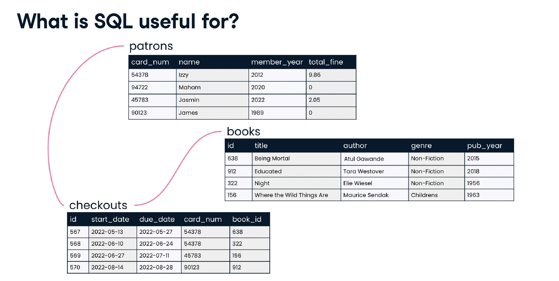

Slide 61
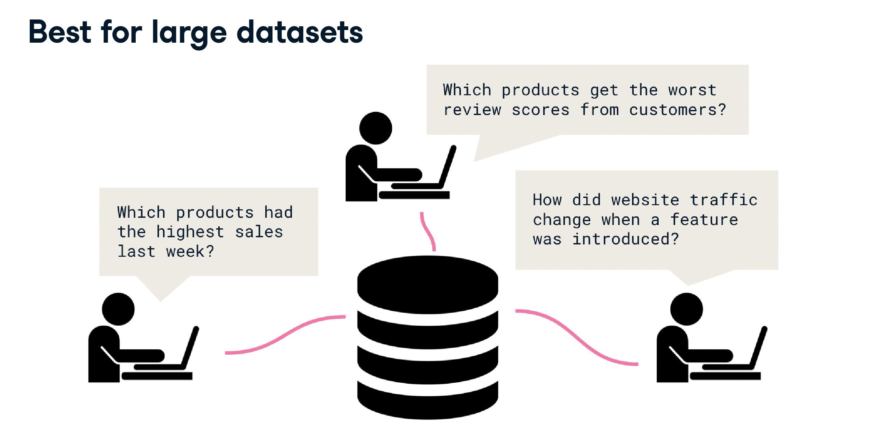

Slide 62
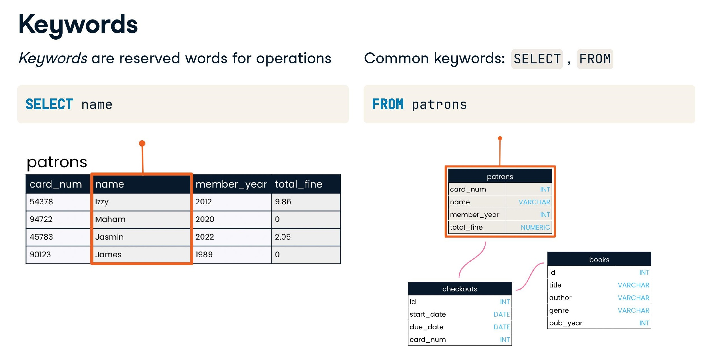

Slide 63
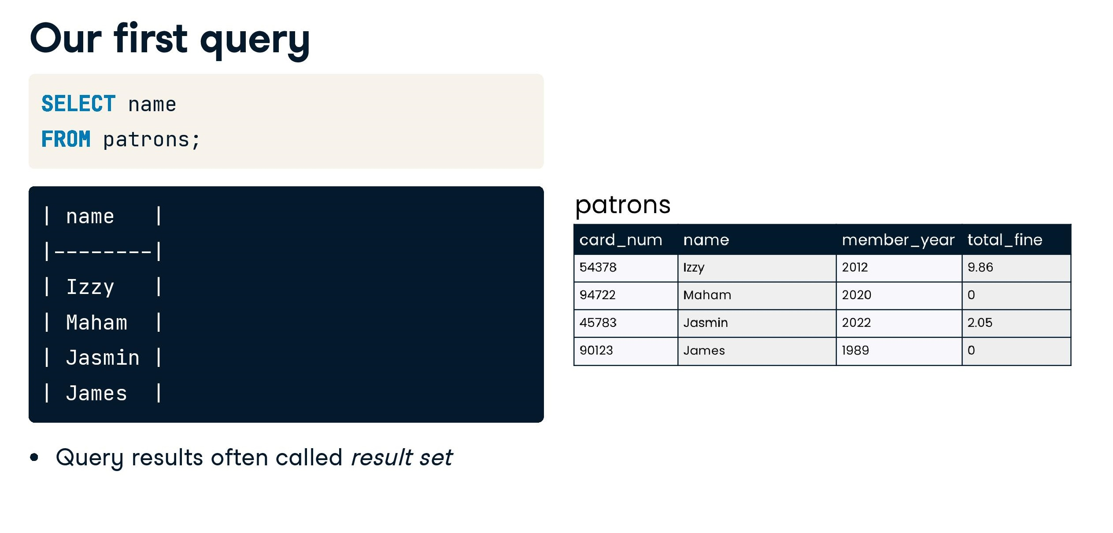

Slide 64
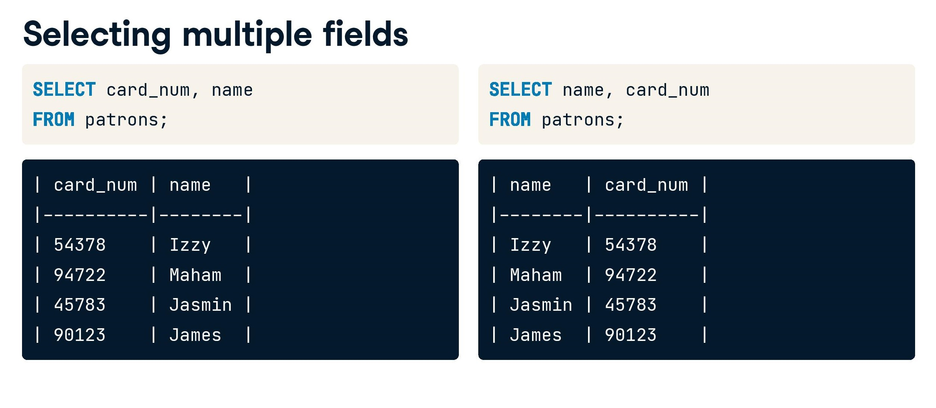

Slide 65
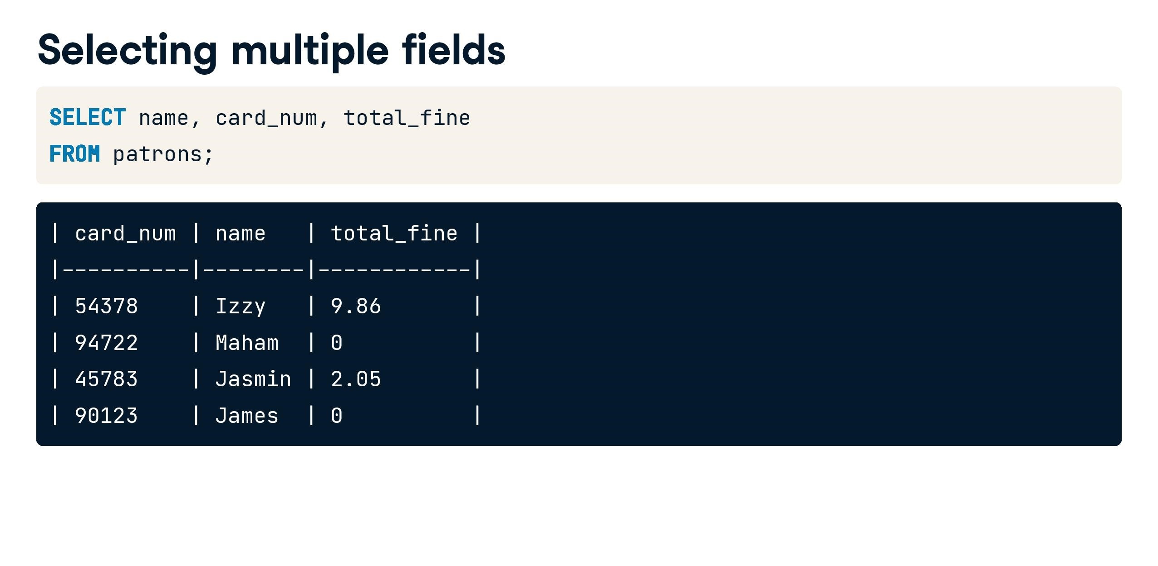

Slide 66
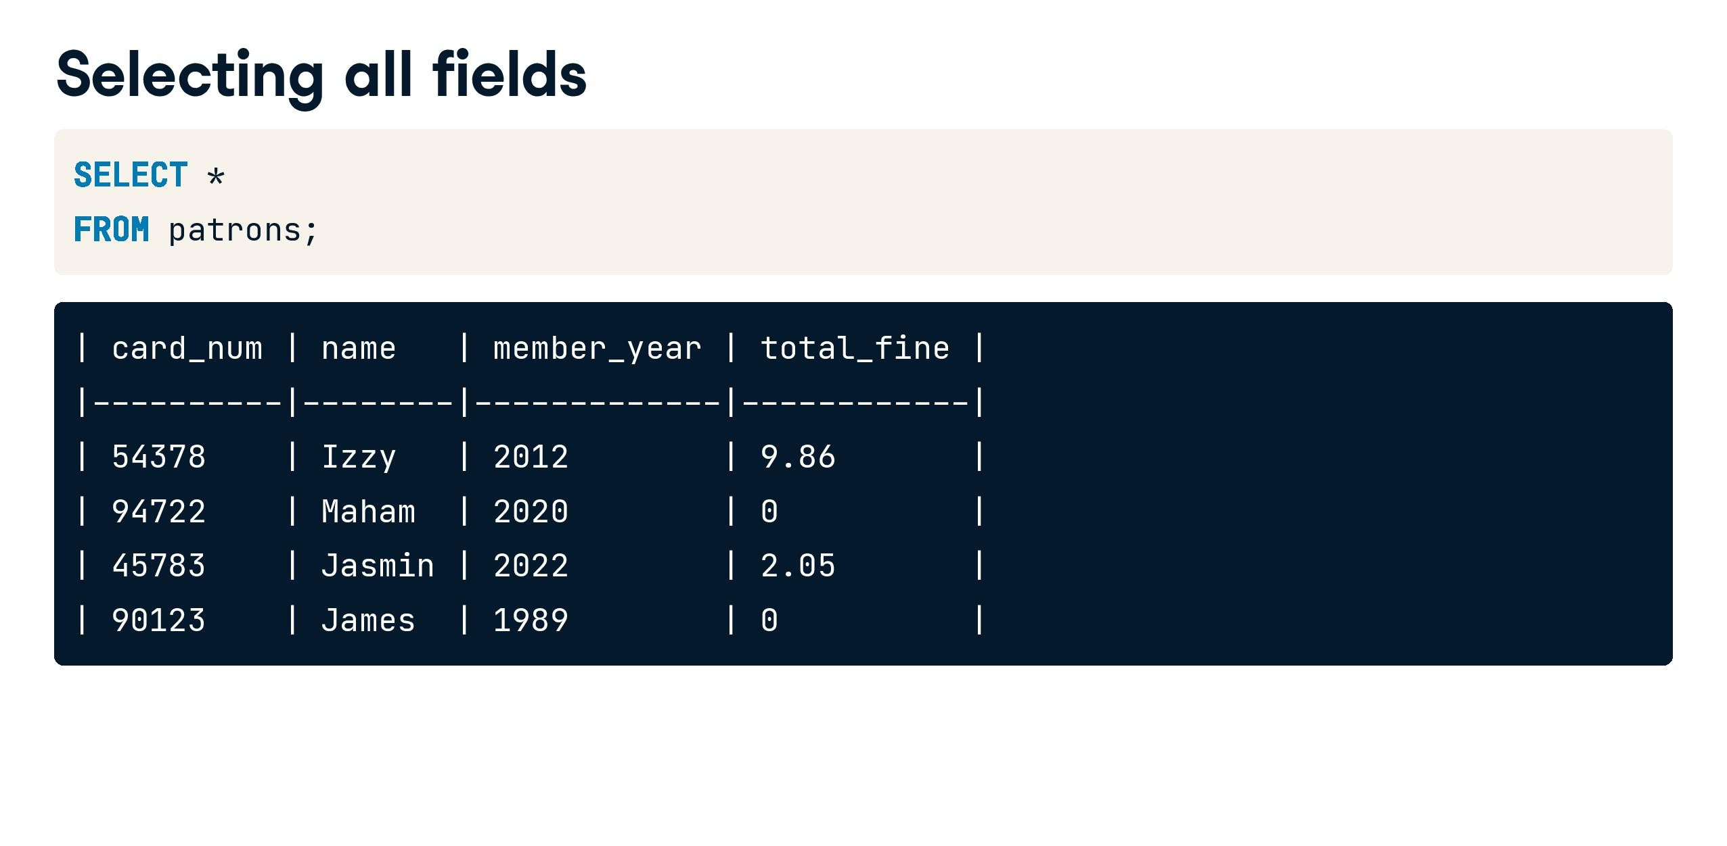

Slide 67


Slide 68
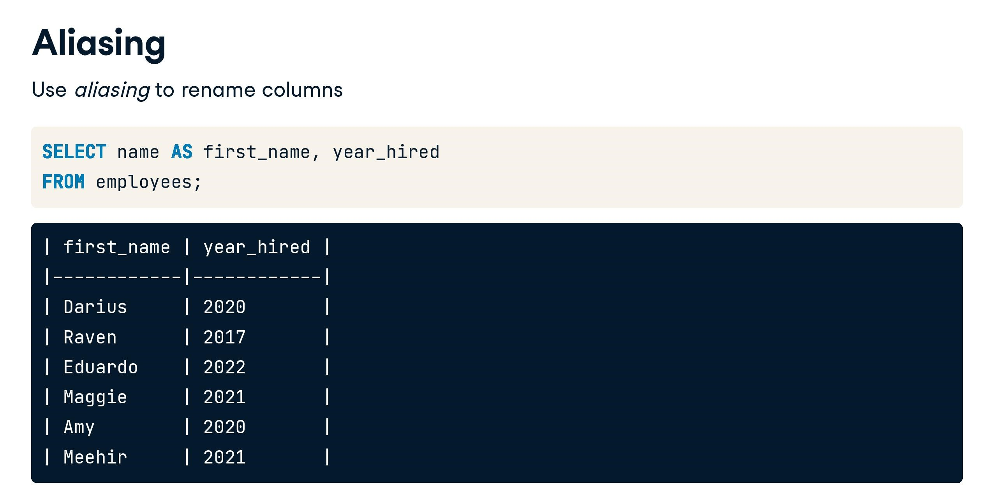

Slide 69
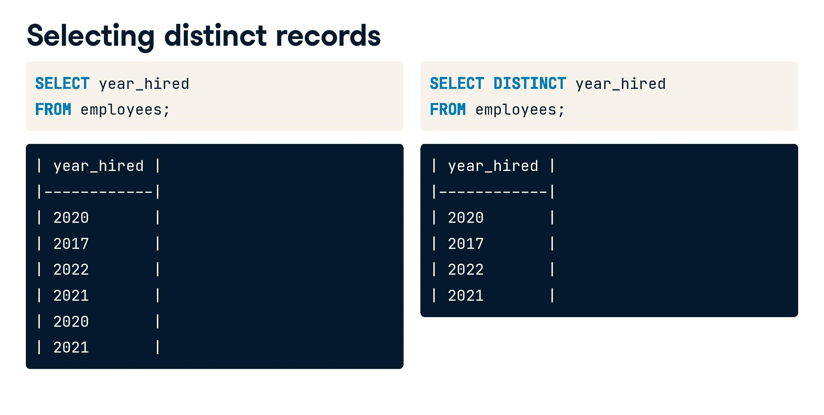

Slide 70
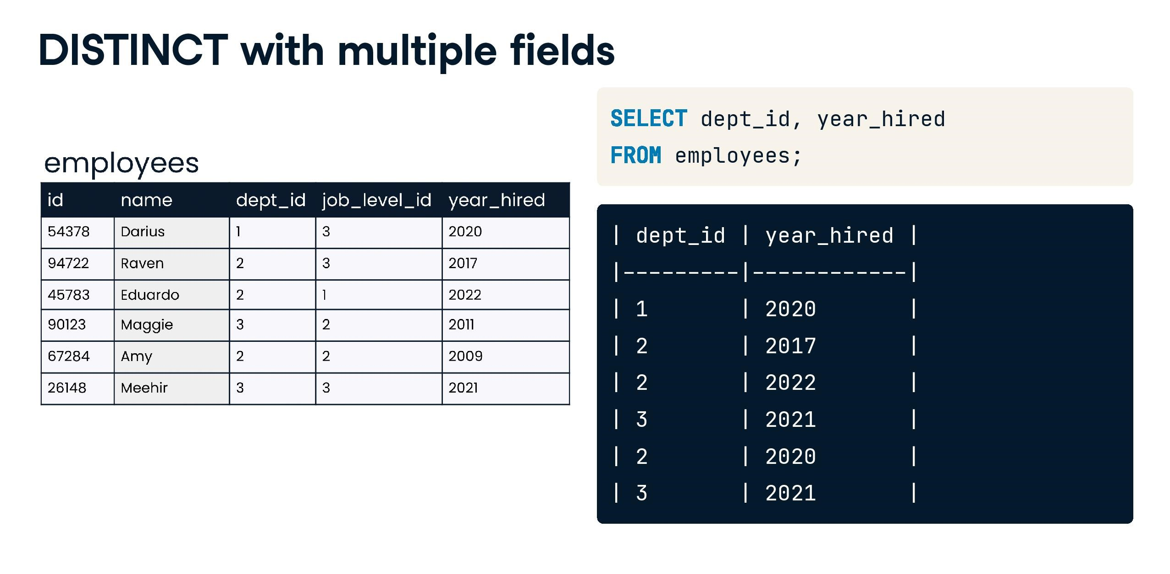

Slide 71
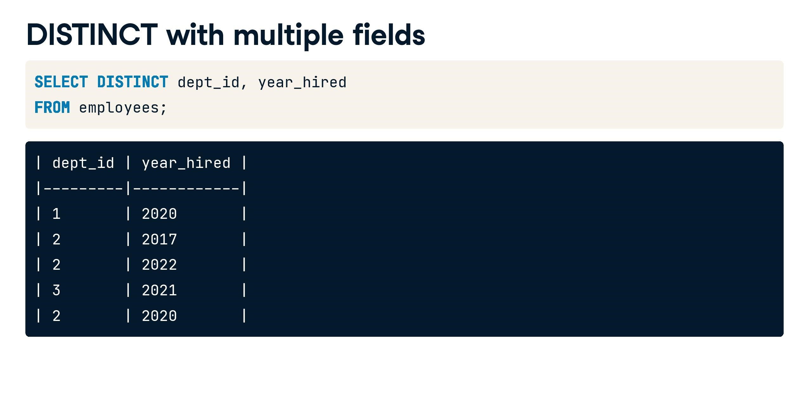

Slide 72
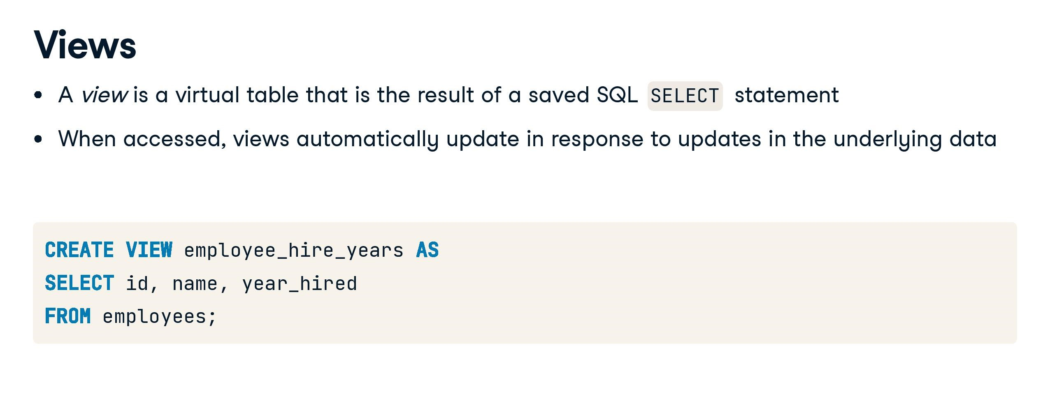

Slide 73
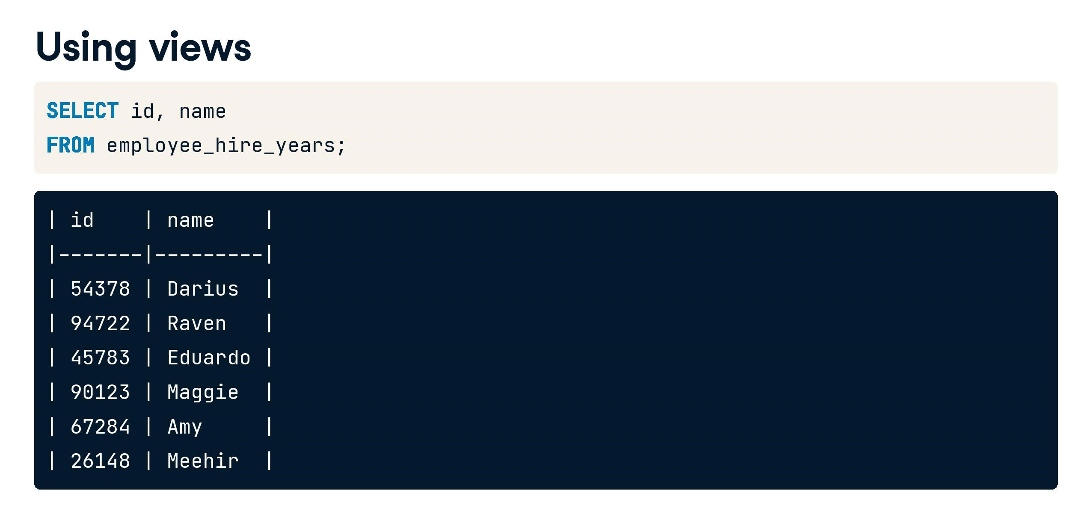

Slide 74
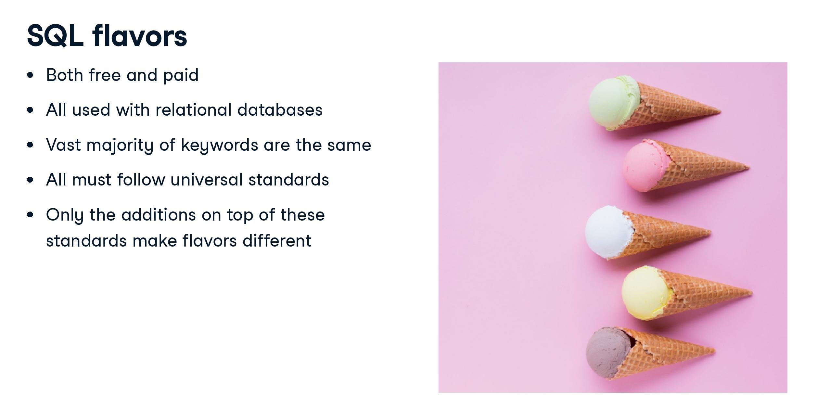

Slide 75
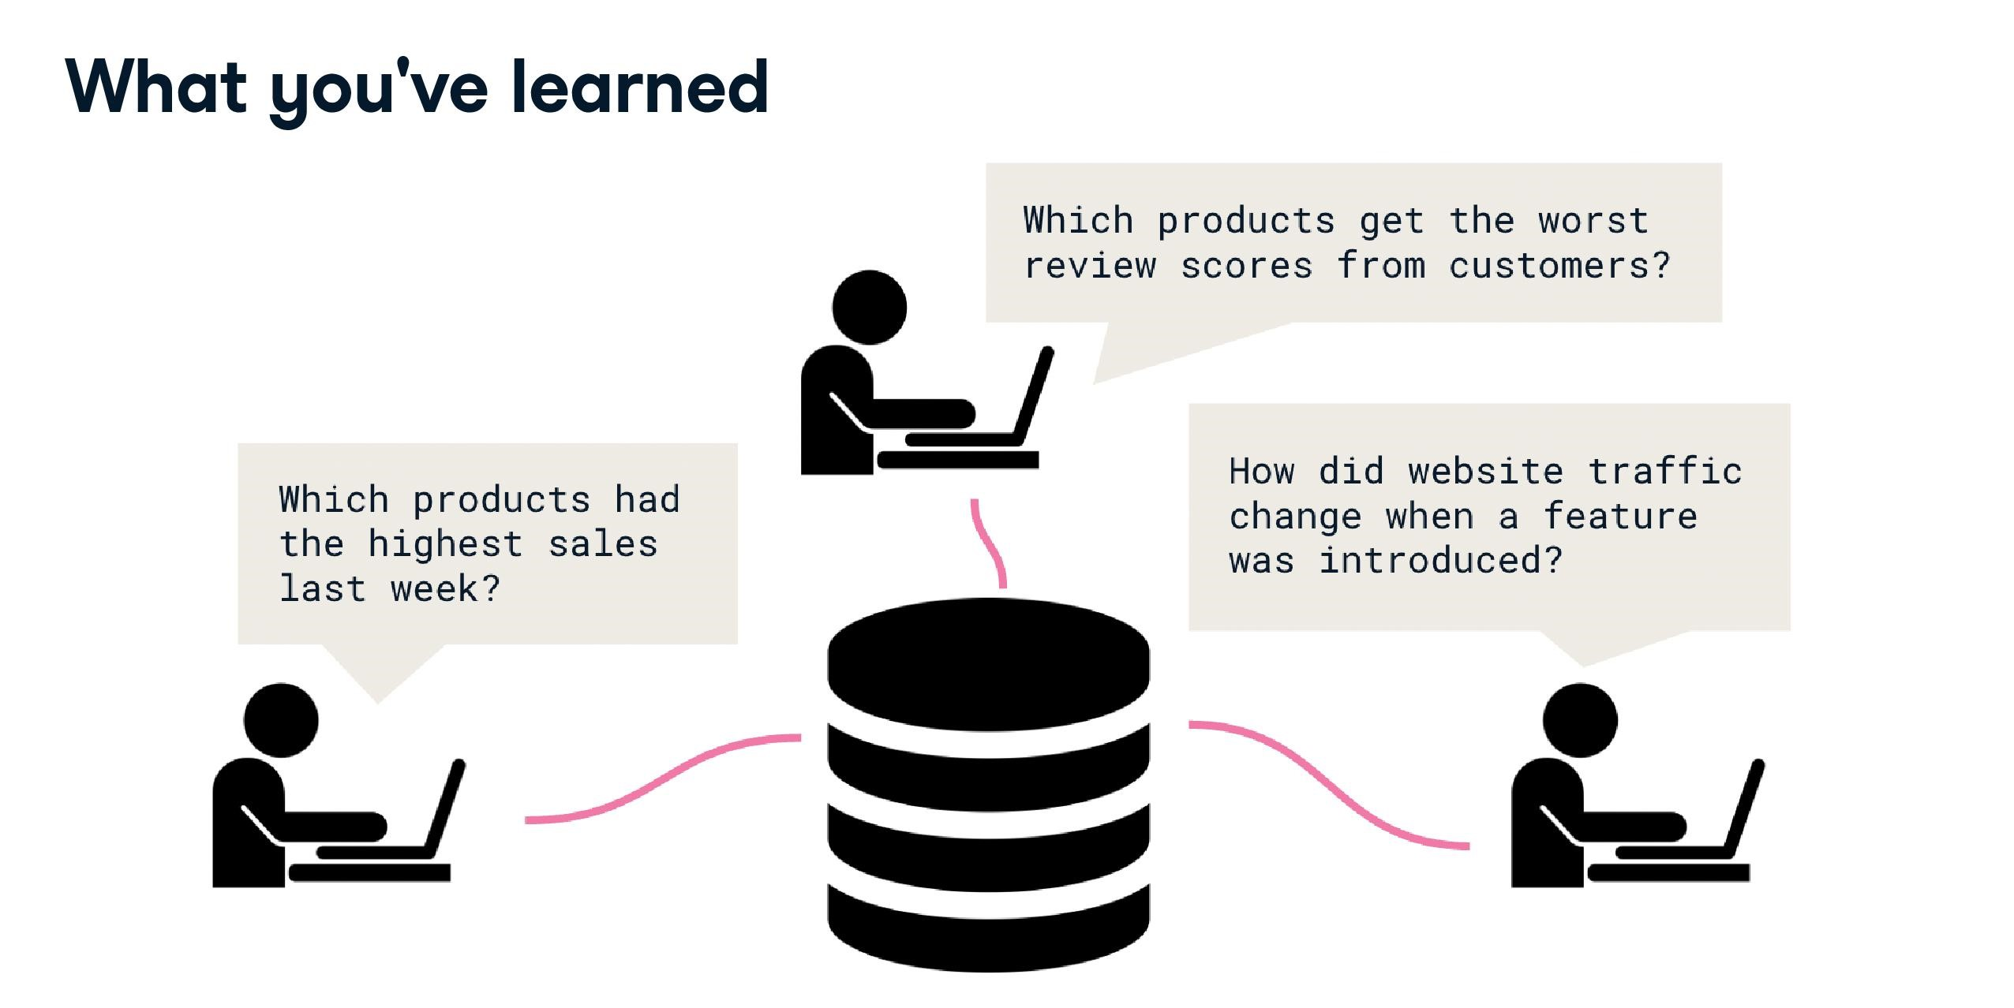

Slide 76
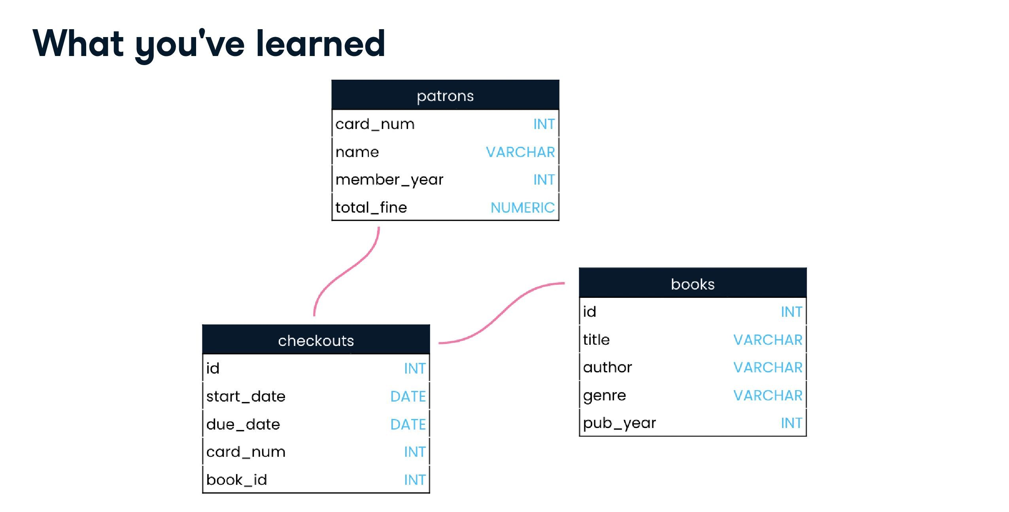

Slide 77
